Slide 1
Attendance Management System
Done by
Konduru Tharun
Shaik Jafer Ali
Chettamoni Vamshi Krishna

Slide 2
CONTENT
INTRODUCTION………………...
OVERVIEW……………………….
MODULES………………………...
SAMPLE CODE…………………..
OUTCOME………………………..

Slide 3

Introduction :
Attendance Management System makes the user convenient to access and mark attendance at any time any where.
It makes the task more easier to mark attendance of any student it is user friendly to the user.
the whole in formation is recorded in the data base it makes the user to store and the record the data of any day this helps mainly in the universities and schools to make the task more convenient for staff to use.

Slide 4

overview
A student attendance management system is an online way of tracking, monitoring, and compiling daily student attendance data. It allows faculty to create and maintain 100% accurate student attendance reports, absentee records, attendance history & other related documents with a click of the mouse.

Slide 5

Modules description
Home Page
Login Page
Attendance Page
Feedback and policy

Slide 6
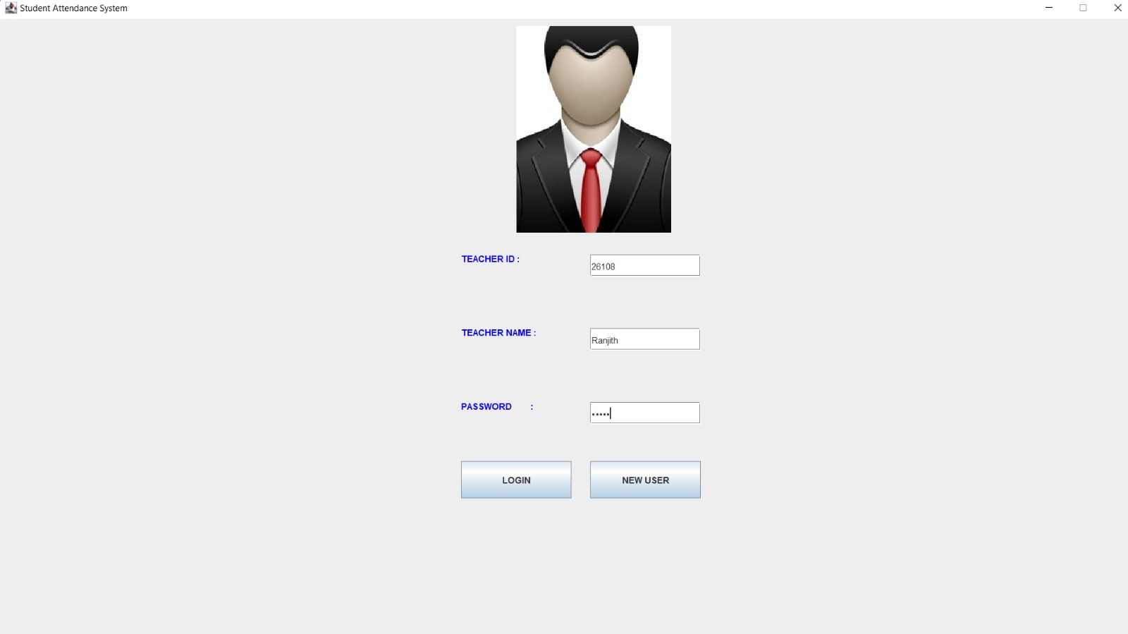
login Page
The login module is a core module of the application, providing users with secure access to their accounts.
When a user logs in using teacher ID, Name and password, the system looks for the same data from the database provided.
If the credentials doesn't match the system gives a prompt to register to the user.
If the credentials are matched, system continues to the second method.

Slide 7
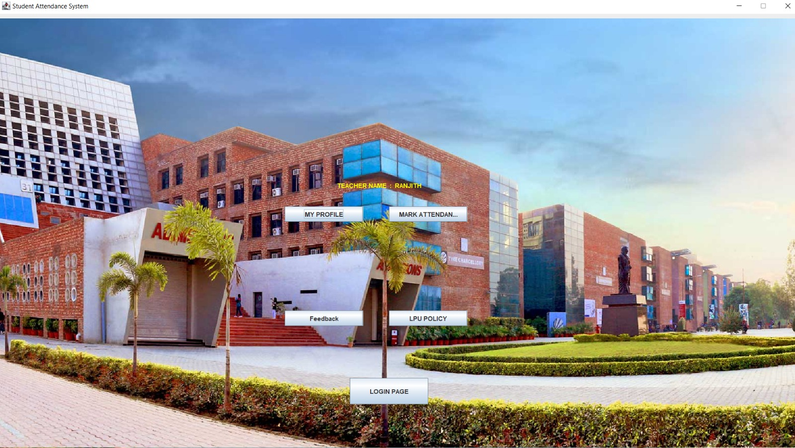
HOME PAGE
Home page consists of myprofile module, mark attendance module, feedback module, and lpu policy
We provide options to the user to select one from.
The home page output will be depend on the input of user.

Slide 8

Attendance page
This module is used to mark the attendance by the user.
The user has to enter the details of the student to mark his attendance.
The marked attendance will be stored in the database.

Slide 9
Feedback and policy
in feedback module is used to take feedback from the user to enhance the system.
In policy module we included the cases, like umc and indiscipline, because it is indirectly related to the students.
If the user wants to file a case, he needs to enter the details of the student and reason for the case.

Slide 10
conclusion
Overall, the implementation of a digital student attendance management system can lead to better student performance, improved communication between teachers and parents, and increased accountability for student attendance. It is an effective tool that can help educational institutions streamline their attendance tracking processes and improve the overall educational experience for students.

Slide 11


Future enhancements
Fingerprint
Face Recognition
Iris or Palm
DNA – based recognition
Customised reporting

Slide 12
THANK YOU

